Slide 1



SUSTAINABLE FEATURE REDUCTION FOR PARKINSON’S DISEASE DETECTION USING NEURAL NETWORKS

Slide 2
OUR TEAM
Hassan Alnasser (202172010)
Naif Alqahtani (202172110)

Slide 3
MOTIVIATION
  Parkinson’s disease affects speech patterns
  (jitter, shimmer, noise).
  Voice-based models can give non-invasive early screening.
  Typical ML pipelines use many correlated features, leading to unnecessary complexity.
  “Can we reduce the number of features while keeping similar accuracy?” Sustainable models: fewer parameters, less training time, lower energy.

Slide 4
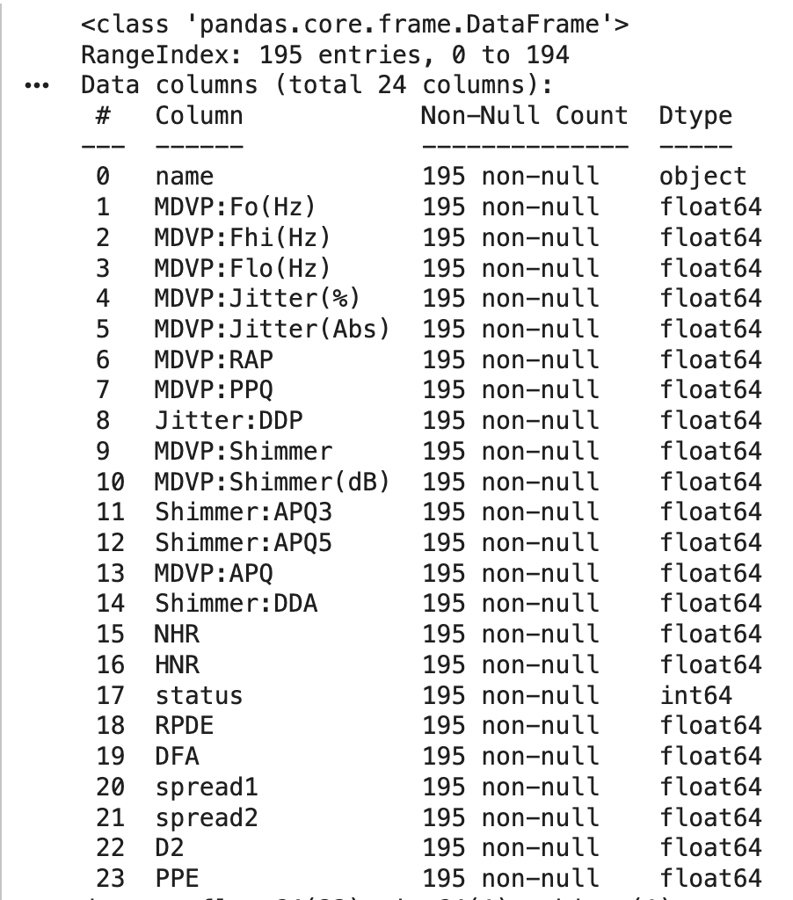
DATASET OVERVIEW
  Source: Voice recordings of individuals with and without Parkinson’s.
  Samples: 195 observations
  Features: 22 acoustic measures, e.g.
  Target variable: status
    0 = healthy
    1 = Parkinson’s

Slide 5
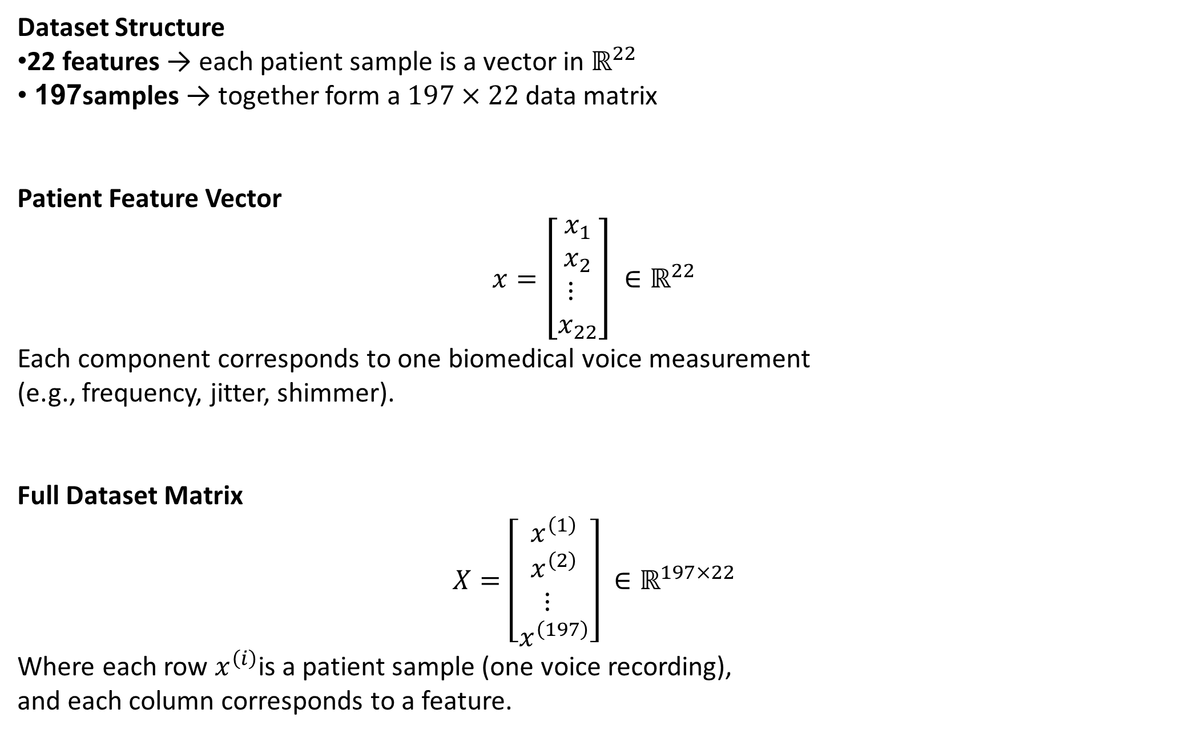
DATASET OVERVIEW
Dataset Structure
22 features → each patient sample is a vector in $ℝ^{22}$
197 samples → together form a $197×22$ data matrix
Patient Feature Vector
$$x=\left[\begin{matrix}x_{1} \\ x_{2} \\ ⋮ \\ x_{22}\end{matrix}\right] ∈ℝ^{22}$$
Each component corresponds to one biomedical voice measurement
(e.g., frequency, jitter, shimmer).
Full Dataset Matrix
$$X=\left[\begin{matrix}x^{\left(1\right)} \\ x^{\left(2\right)} \\ ⋮ \\ x^{\left(197\right)}\end{matrix}\right] ∈ℝ^{197×22}$$
Where each row $x^{\left(i\right)}$is a patient sample (one voice recording),
and each column corresponds to a feature.

Slide 6
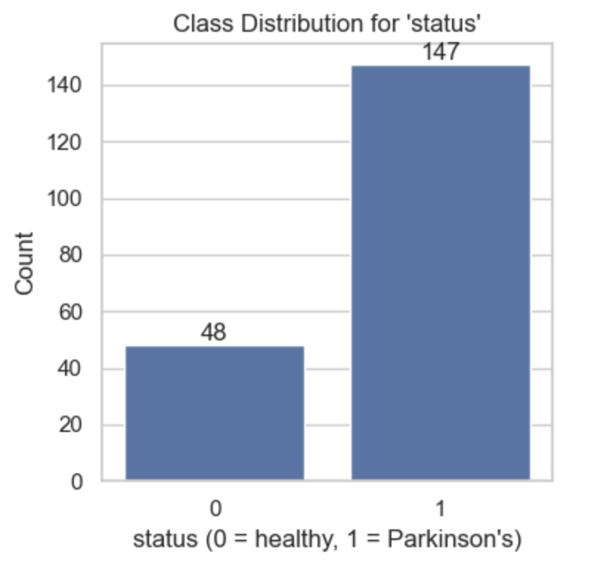
CLASS DISTRIBUTION & PREPROCESSING
No missing values in the dataset.
Split into train/test (and validation later) using stratified sampling.
Class counts:
  status = 0 (healthy): 48
  status = 1 (Parkinson’s): 147
Clear class imbalance (~75% Parkinson’s).
This affects evaluation: accuracy alone can be misleading.

Slide 7
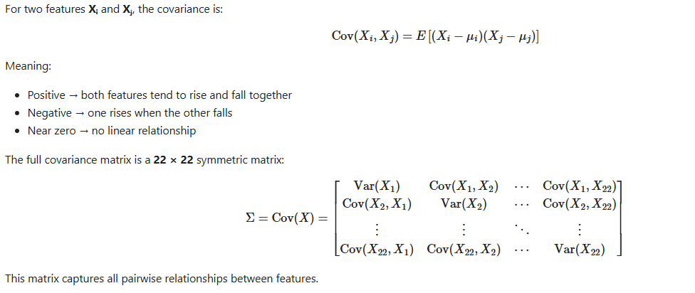
Covariance Between Features

Slide 8
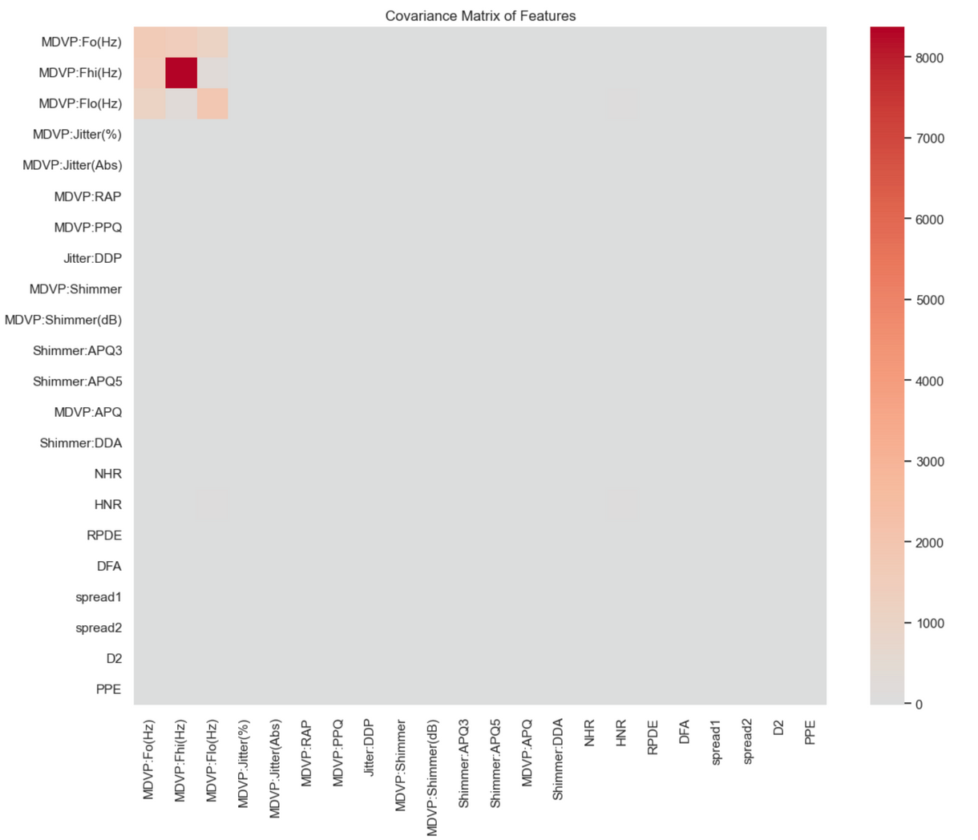
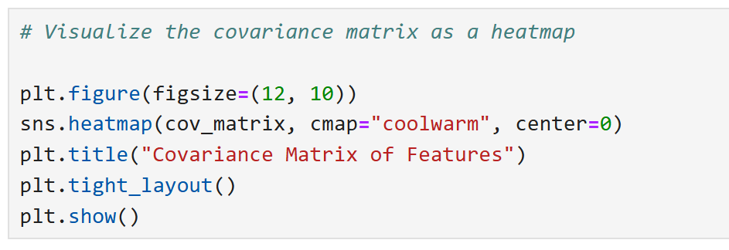
Covariance Between Features

Slide 9
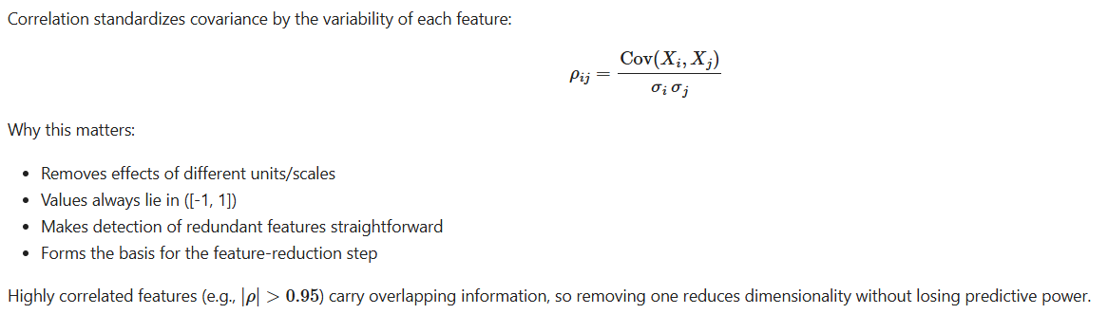
CORRELATION MATRIX

Slide 10
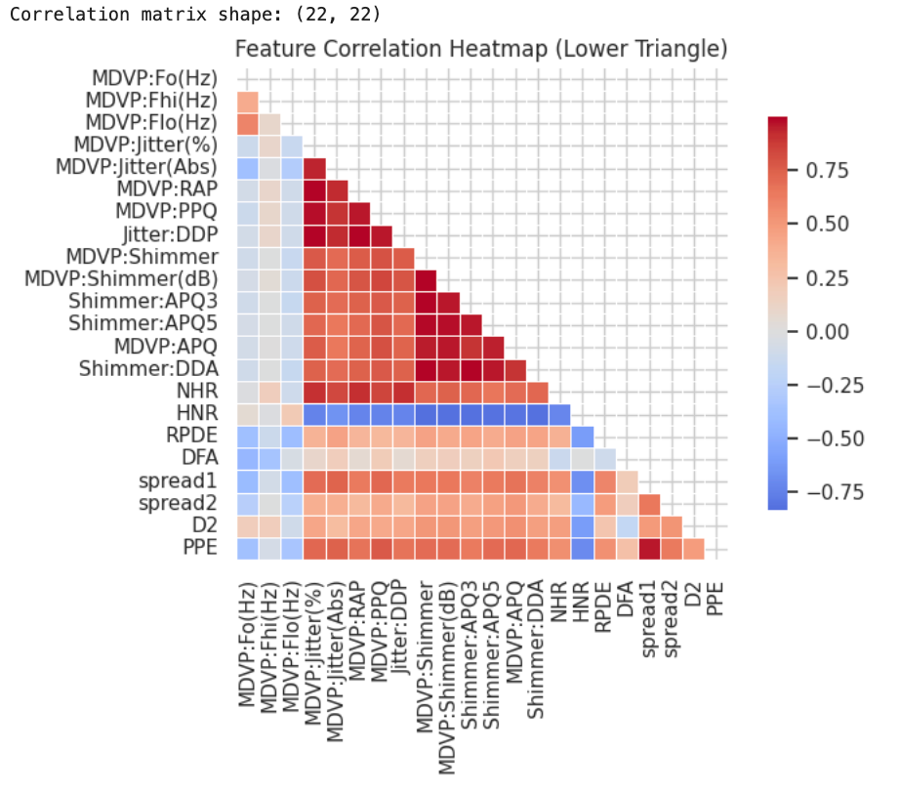
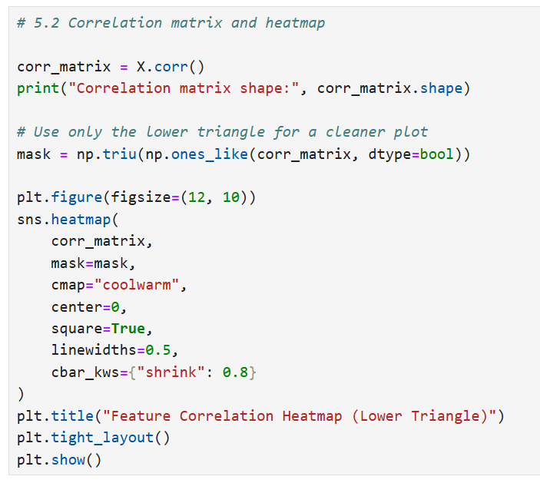
CORRELATION MATRIX

Slide 11
PAIRWISE STRUCTURE IN THE DATA
Pairplots of selected features colored by status.
Observations:
  Parkinson’s patients often show:
    Higher jitter and shimmer.
    Lower HNR (more noise in the voice).
  Some 2D plots show partial separation of classes.
  But no single feature perfectly separates classes → we rely on combinations (high-dimensional geometry).

Slide 12
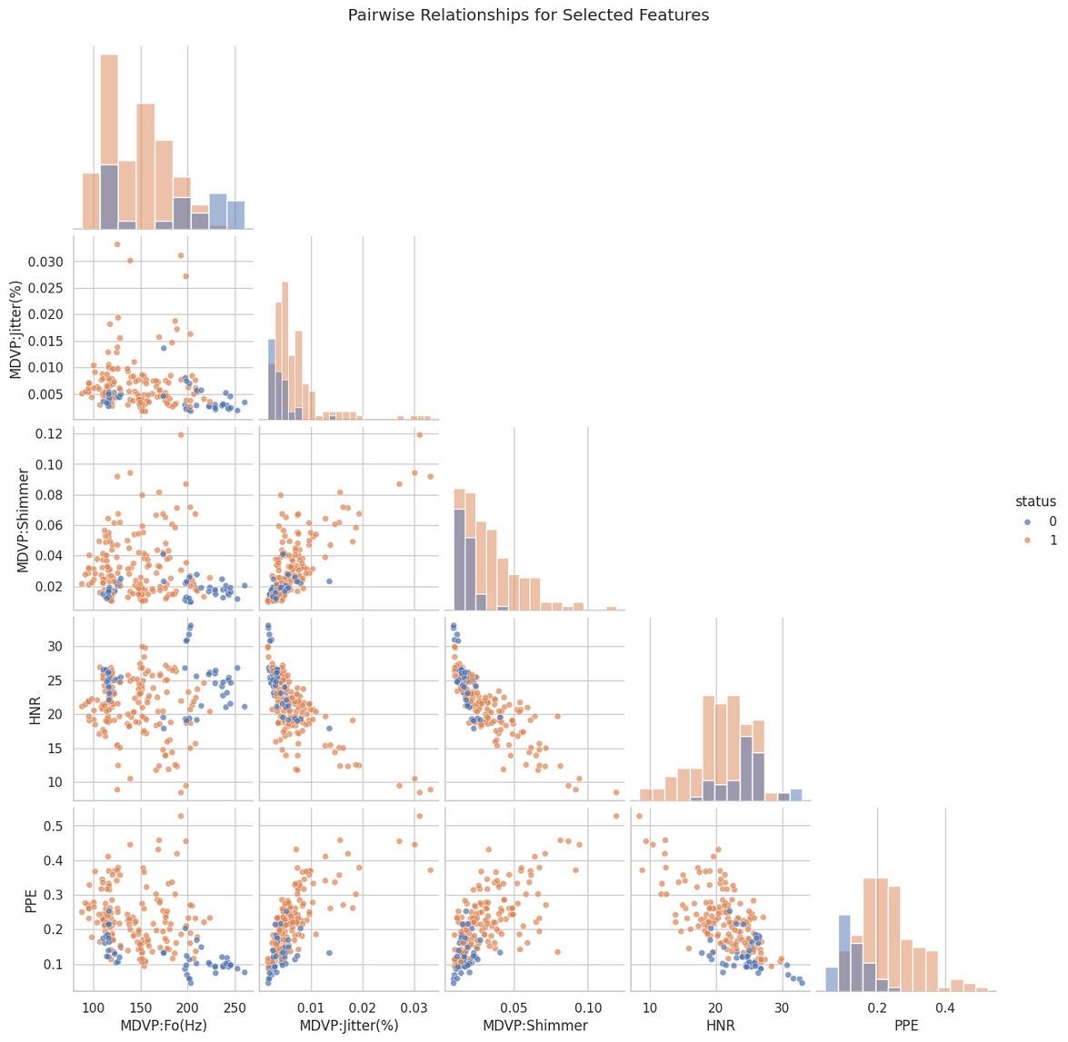
PAIRWISE STRUCTURE IN THE DATA

Slide 13
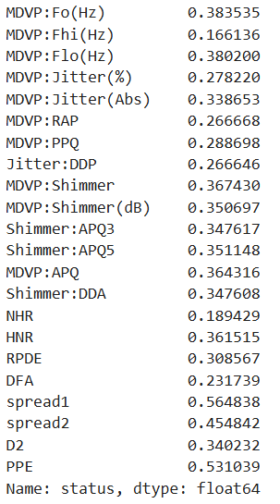
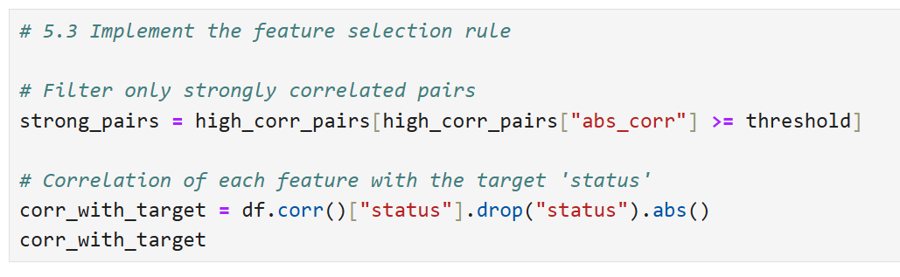
CORRELATION-BASED FEATURE SELECTION
Threshold:∣corr(fi​, fj​)∣≥0.85 → features are “too similar”.
For each such pair (f1,f2):
  Compute∣corr(fk​, status)∣ for each feature.
  Drop the feature with a lower correlation with the target.

Slide 14
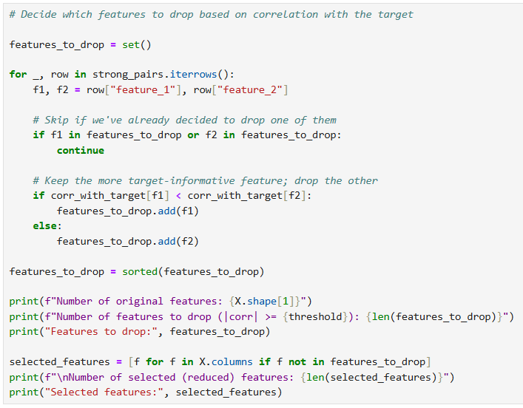
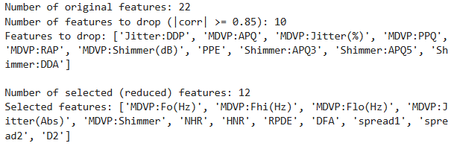
CORRELATION PATTERNS & REDUNDANT FEATURES

Slide 15
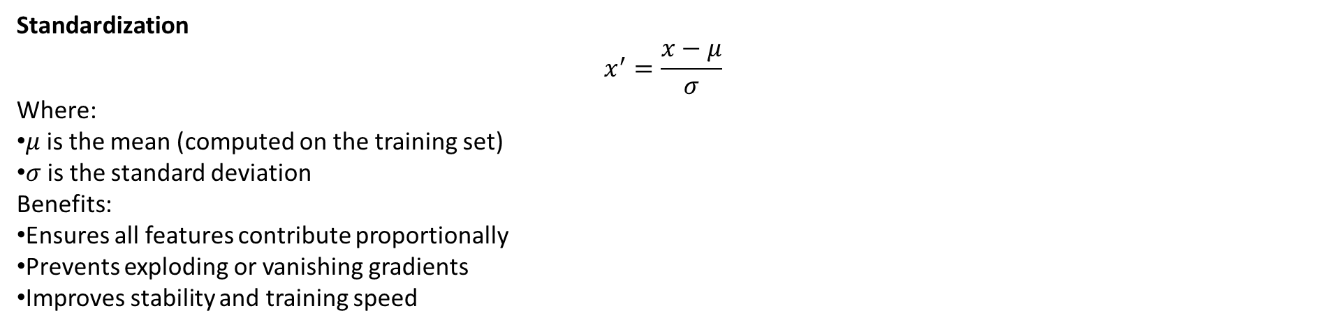
Preparing Data for Neural Networks
Why Data Preparation Matters for Neural Networks
Neural networks rely on gradient-based optimization, which is sensitive to input scale.
Features with different ranges can:
  Dominate gradients
  Slow or destabilize training
  Cause poor convergence
Standardization
$$x^{′}=\frac{x−μ}{σ}$$
Where:
$μ$is the mean (computed on the training set)
$σ$is the standard deviation
Benefits:
Ensures all features contribute proportionally
Prevents exploding or vanishing gradients
Improves stability and training speed
Train–Validation Split
We divide the training data into:
Training set: updates neural network weights
Validation set: tunes hyperparameters and prevents overfitting
This is done for both:
Full feature dataset (22 features)
Reduced feature dataset (12 features)

Slide 16
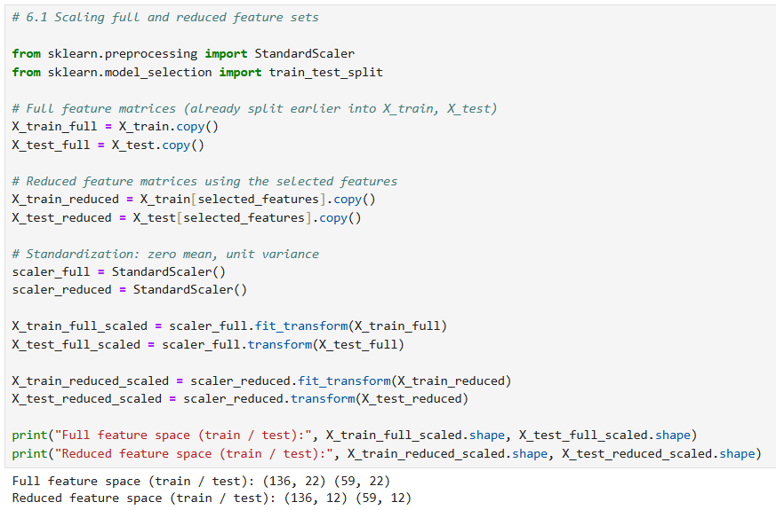
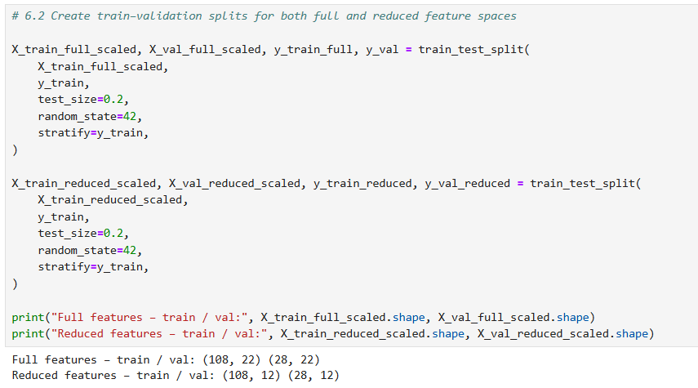
Preparing Data for Neural Networks

Slide 17
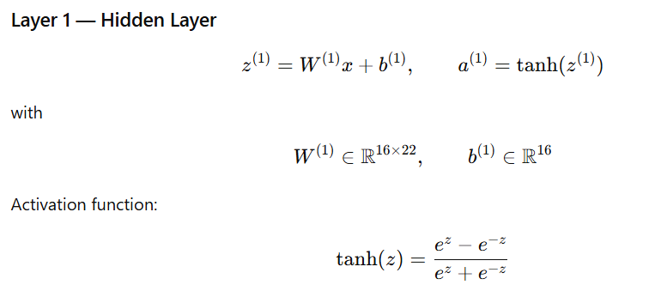
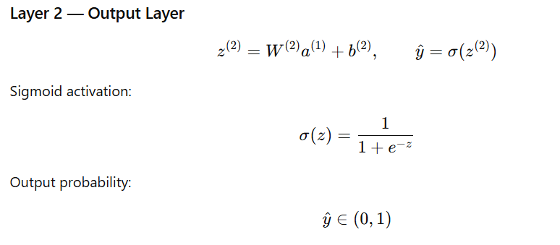
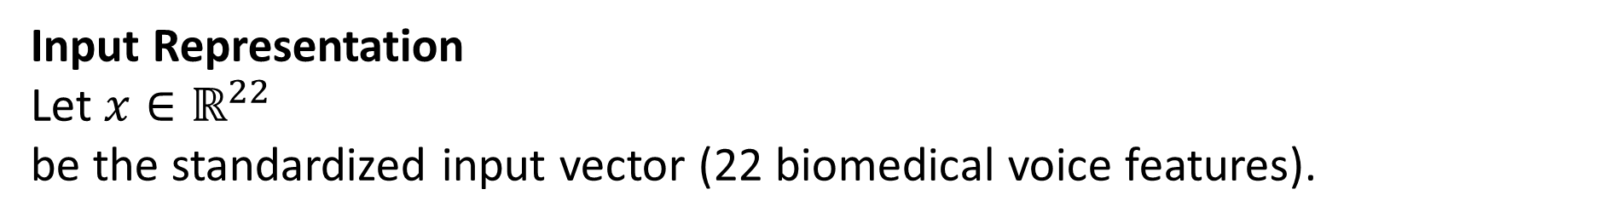
Network Architecture (Full Features)
Input Representation
Let $x∈ℝ^{22}$
be the standardized input vector (22 biomedical voice features).

Slide 18
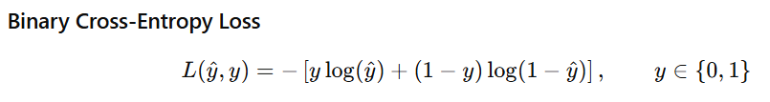
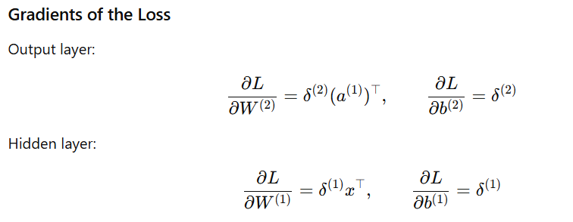
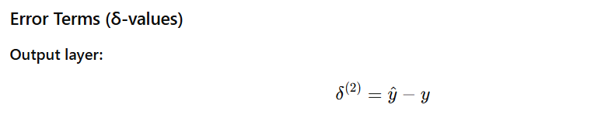
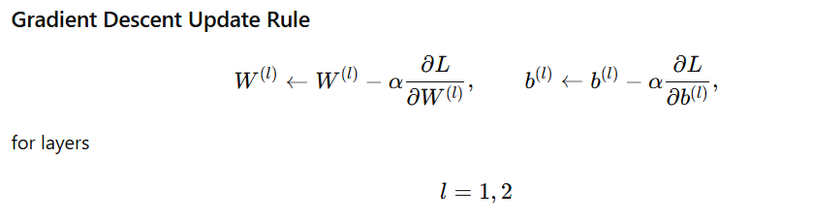
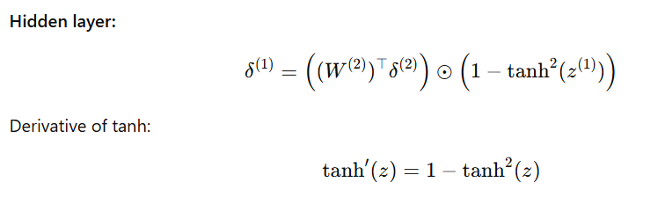
Loss Function, Backpropagation and Gradient Computation

Slide 19
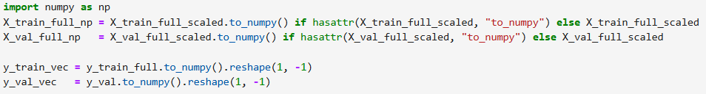
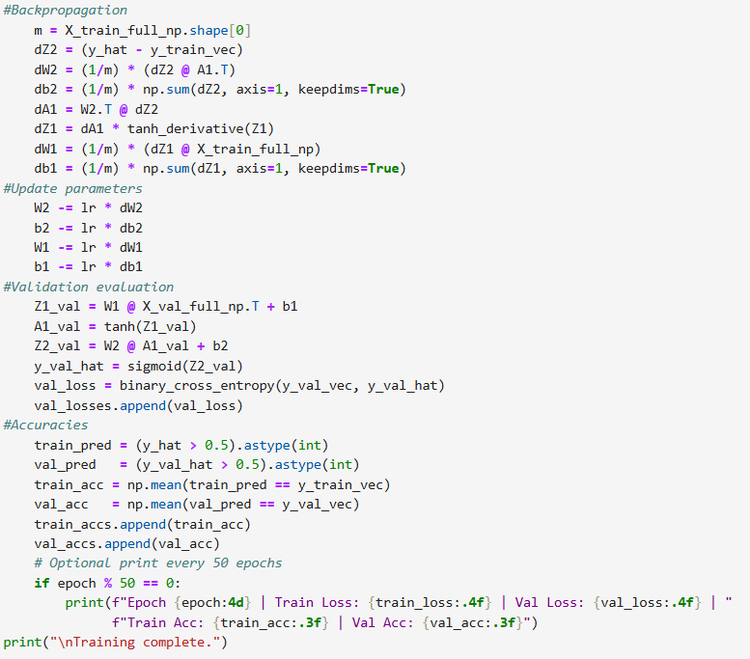
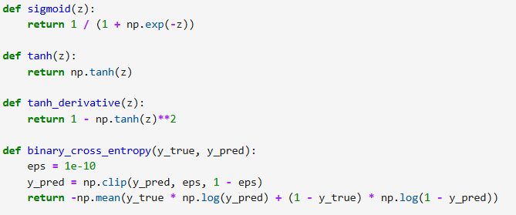
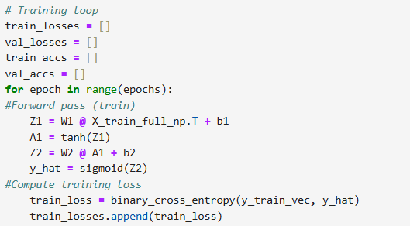
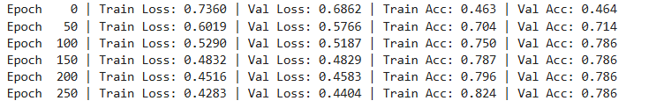
Neural Network Implementation

Slide 20
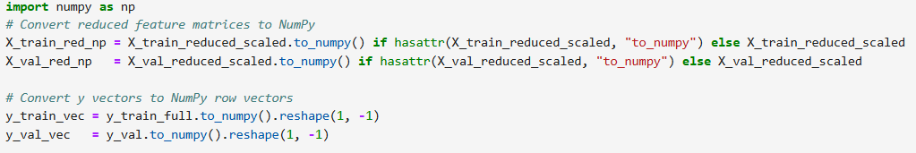
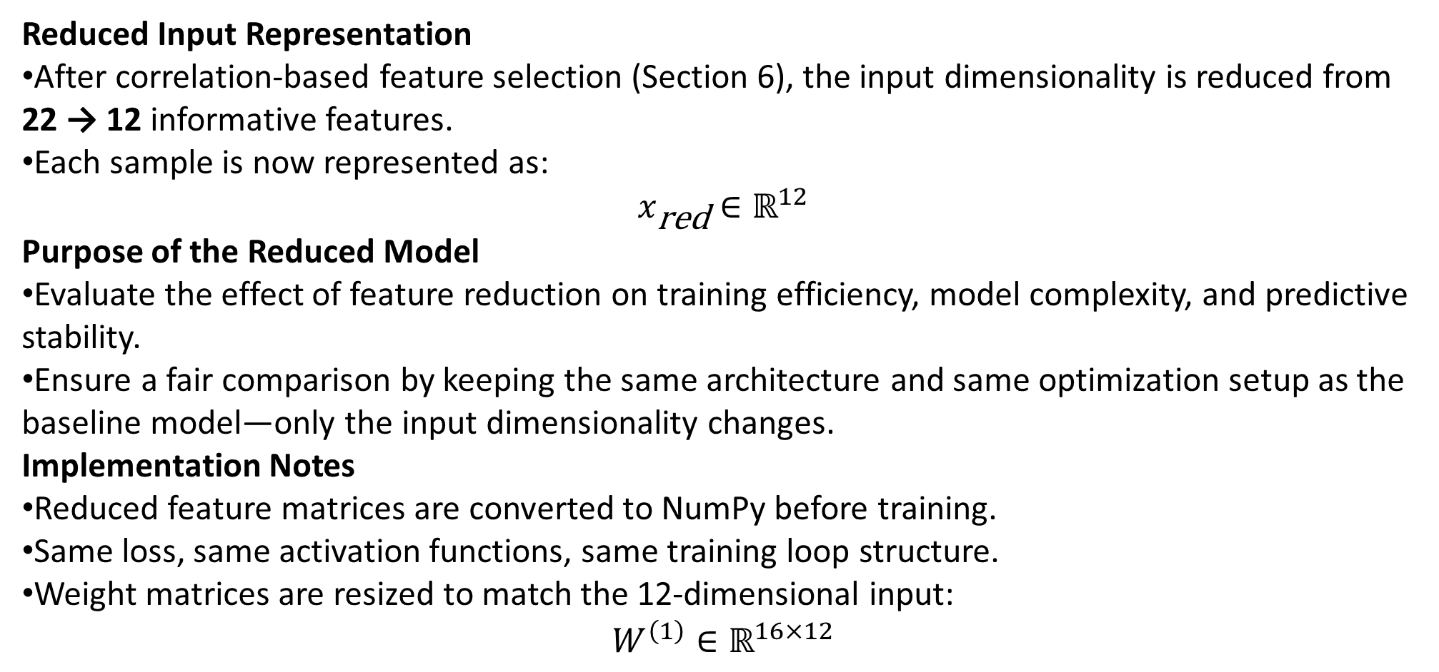
Reduced-Feature Neural Network (Concept & Setup)
Reduced Input Representation
After correlation-based feature selection (Section 6), the input dimensionality is reduced from 22 → 12 informative features.
Each sample is now represented as:
$$x_{\text{red}}∈ℝ^{12}$$
Purpose of the Reduced Model
Evaluate the effect of feature reduction on training efficiency, model complexity, and predictive stability.
Ensure a fair comparison by keeping the same architecture and same optimization setup as the baseline model—only the input dimensionality changes.
Implementation Notes
Reduced feature matrices are converted to NumPy before training.
Same loss, same activation functions, same training loop structure.
Weight matrices are resized to match the 12-dimensional input:
$$W^{\left(1\right)}∈ℝ^{16×12}$$

Slide 21
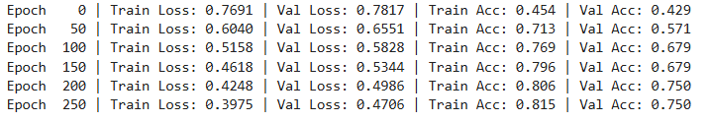
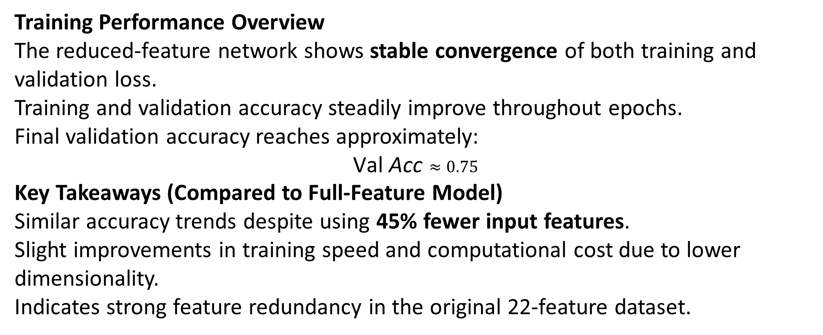
Training Behavior & Performance
(Reduced Features)
Training Performance Overview
The reduced-feature network shows stable convergence of both training and validation loss.
Training and validation accuracy steadily improve throughout epochs.
Final validation accuracy reaches approximately:
$$\text{Val} \text{Acc}≈0.75$$
Key Takeaways (Compared to Full-Feature Model)
Similar accuracy trends despite using 45% fewer input features.
Slight improvements in training speed and computational cost due to lower dimensionality.
Indicates strong feature redundancy in the original 22-feature dataset.

Slide 22
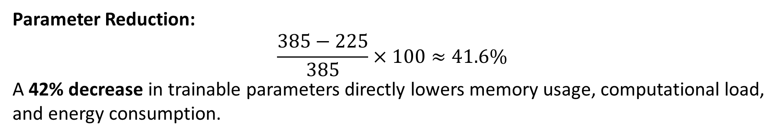
Quantitative Sustainability Analysis
Why Compare Sustainability?
Reducing input dimensionality directly decreases computational cost without altering the network architecture.
Component | Formula | Full Model (d = 22) | Reduced Model (d = 12)
Input → Hidden | (16d + 16) | (16 \cdot 22 + 16 = 352 + 16 = 368) | (16 \cdot 12 + 16 = 192 + 16 = 208)
Hidden → Output | (16 + 1 = 17) | 17 | 17
Total Parameters | — | 385 | 225
Parameter Reduction:
$$\frac{385−225}{385}×100≈41.6\%$$
A 42% decrease in trainable parameters directly lowers memory usage, computational load, and energy consumption.

Slide 23
Sustainability Impact & Interpretation
Accuracy Comparison (Validation):
Full-feature model: 78.6%
Reduced-feature model: 75.0%
A small drop in accuracy is offset by large sustainability gains:
Efficiency Improvements
42% fewer parameters → smaller memory footprint.
Faster forward/backward passes → lower computational and energy cost per epoch.
Lower computation per iteration → more scalable and deployment-friendly.
Key Insight
Because both models share identical architecture and hyperparameters, improvements come solely from reduced input dimensionality.
The reduced-feature model is a more sustainable alternative that retains most predictive performance while significantly lowering computational cost.

Slide 24
CONCLUSION
In this project, we developed a complete pipeline for analyzing and modeling the Parkinson’s disease dataset using both statistical and neural-network-based methods. Through correlation analysis, we identified redundancy in the original 22-dimensional feature space and reduced it to 12 carefully selected features while preserving most of the relevant structure. The baseline neural network achieved a validation accuracy of 78.6%, and after dimensionality reduction the reduced-feature model still reached 75.0% accuracy, showing that the removed features contributed limited additional information. Importantly, decreasing the input dimension reduced the total number of trainable parameters by approximately 42%, resulting in a lighter, faster, and more computationally sustainable model. Overall, our results demonstrate that feature reduction is an effective strategy for improving model efficiency without significantly compromising predictive performance, offering a strong balance between accuracy and computational cost and making the reduced-feature model a more sustainable choice for real-world deployment.

Slide 25
THANK
YOU

